Slide 1
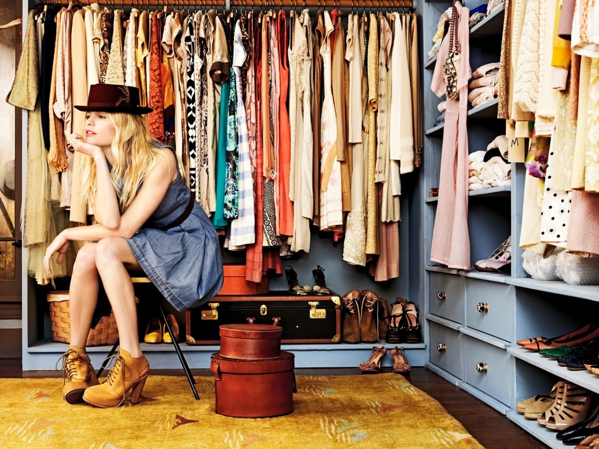
Closet
About us
Explore
Team
Contact
An online platform to trade, exchange, and rent things in your closet.

Slide 2

Closet
About us
Explore
Team
Contact
Nina trades her designers purse on Closet.
Learn her story >

Slide 3
Closet
About us
Explore
Team
Contact

